Slide 1
Hypothesis Testing
DSP Class Session
Notes:
I will present Hypothesis testing. What is it?

Slide 2
Introduction significance testing/hypothesis testing
Hypothesis testing is a technique to evaluate a theory using data
‘Hypothesis’ refers to the researcher’s initial belief about the situation before the study
Hypothesis testing:
1. T-Test 2. Wilcoxon Test 3. Chi-square Test
Notes:
Hypothesis testing is a tool/technique to evaluate a theory using data.
Based on its name, hypothesis refers to initial belief of researcher about the situation before the study.
In here we will explain 3 hypothesis testing. Ttest, Wilcoxon test,and last, chi square test

Slide 3
intuition significance testing/hypothesis testing
Case 1
Case 2
Average Accuracy
No. | M₀ | M₁
1 | 79 | 80
2 | 80 | 80
3 | 79 | 80
4 | 81 | 80
Means | 79.75 | 80
No. | M₀ | M₁
1 | 80 | 80
2 | 80 | 81
3 | 79 | 78
4 | 80 | 81
Means | 79.75 | 80
√?
M₀
M₁
79.75%
80%
Do hypothesis testing answer accuracy of M₁ is better than M₀?
P-value: 0.620
P-value: 0.750
The most important answer:
How consistent is the accuracy of M₁ superior to M₀.
The significance difference of two models is showed by p-value
Notes:
Why we need to learn hypothesis testing?
This is the intuition of hypothesis testing.
When we have average accuracy of baseline and proposed model like this.
Do hypothesis testing answer accuracy of proposed model is better than baseline?
So here we compare two cases that have the same average accuracy of baseline and so do proposed models.
Which Case reflects proposed model is better?
We can perform hypothesis testing and get p-value for each case. The lower p-value means the case has significance difference to other case.
Based on pvalue, case 1 has lower pvalue which means case 1 has consistent superior accuracy of proposed model to baseline model than case2.

Slide 4
Data Science Flow
Let`s start!
1
Data Collection
CGIs, Sampling Automation
Data Preprocessing
2
Median Filter, Data cleansing
3
Feature Extraction
EM, GMM, HHT, PCA, LDA, etc.
Transformation
4
Histogram, KLD, EMD, K-Means, Kernel Mapping
5
Feature Selection
T-Test, Chi-Square, Wilcoxon Signed Rank Test
Experiment Design
6
Random Sampling, Cross Validation, LOPO
Result
FAR, FRR, EER, etc.
Notes:
In the experiment, hypothesis testing is performed in feature selection section and result section, like the previous example.

Slide 5
T-TEST
In Class Session
Notes:
Now I will present the first hypothesis testing, T-Test, which is popularly known by researchers

Slide 6
OUTLIne
01
Introduction to T-Test
02
One-Tailed Vs Two-Tailed
03
How to Perform T-Test – (Two-Tailed)
Notes:
I will start explaining TTest. Then there are two types of Ttest, one-tailed and two-tailed. Last, explain step by step performing T-test for two-tailed type.

Slide 7


INTRODUCTION
T-test is used to determine if there is a significant difference between the means of two groups
T-Test assumes the data follows a normal distribution
Null Hypothesis (H₀):
The feature has No differences between the groups
Alternative Hypothesis (H_{A}):
The feature has significance difference of groups
T-Test
Group A
Group B
Group A
Group B
B
25
43
Average: 34
14
48
Average: 31
25
43
Average: 34
554
413
Average: 483
Notes:
I will present what the t-test is. T-test is used to determine if there is a significant difference between the average value of two groups.
When do we use T-tests for our data?
You need to pay attention to the red font here to know the suitable condition when using t-test.
T-Test assumes the data follows a normal distribution. So, if you think your data has normal distribution then t-test is the suitable hypothesis testing.
There are two terms that need to be known when performing the t-test: a null and an alternative hypothesis.
For feature selection cases:
Null Hypothesis means the feature has no difference between two groups
On the contrary, the alternative hypothesis states there is a significant difference between the two groups
The example for null hypothesis, the average feature values of two groups are similar.
On the contrary, the average feature values of two groups in alternative hypothesis example has significant difference.

Slide 8
OUTLIne
01
Introduction to T-Test
02
One-Tailed Vs Two-Tailed
03
How to Perform T-Test – (Two-Tailed)

Slide 9
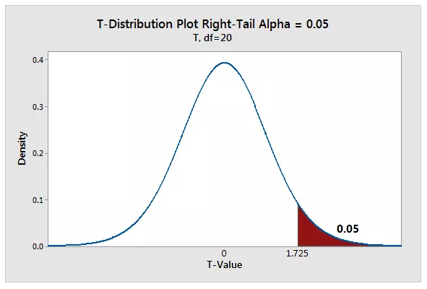
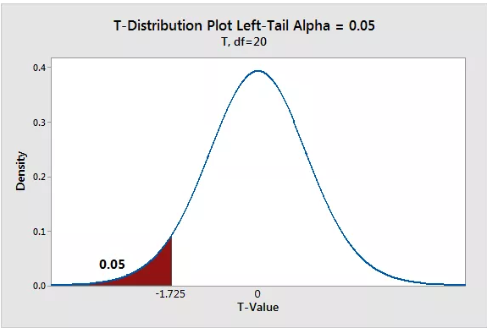
One tailed
When we perform a one-tailed test, the entire significance level percentage goes into the extreme end of one tail of the distribution
Notes:
In the example below, I use an Alpha (significance level) of 5%, 0.05
Each distribution has one shaded region of 5%
When we perform a one-tailed test, we must determine whether the critical region is in the left or the right tail
The test can detect an effect only in the direction that has the critical region
It has absolutely no capacity to detect an effect in the other direction
Therefore, In one-tailed test, we have two options for the null and alternative hypothesis which corresponds to where we place the critical region

Slide 10
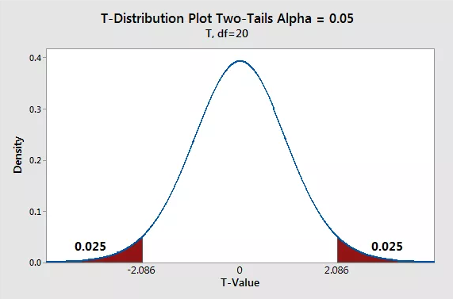
Two-tailed
Using Two-tailed hypothesis, we can test the effects in both directions
When we perform two-tailed test, we split the significance level percentage between both tails of the distribution
Notes:
In the example below, We use the same Alpha of 5%
Difference from one-tailed, The distribution two-tailed has two shaded regions of 2.5%
When a test statistic falls in either critical region, then your sample data are sufficiently incompatible with the null hypothesis that you can reject it for the population

Slide 11
One tailed Vs two tailed
One Tailed
(Directional and One-sided test )
Two Tailed
If we only care the specific prediction about the direction of the difference among two groups → A one-tailed test
If finding any difference between two groups that are comparing
Group A
Group B
Group A
Group B
Group A
Group B
Group A
Group B
H₀: Feature of Group A has no significant difference to Group B
H_{A}: Feature of Group A has significant difference to Group B
H₀: Feature of Group A does not have higher effect than Group B
H_{A}: Feature of Group A has higher effect than Group B
Notes:
Choosing whether to perform a one-tailed or a two-tailed hypothesis test is one of the methodology decisions we might need to make for our analysis.
I will give real examples for these two types of t-test so you can easy to understand.
ONE-Tailed
Example: Feature of Group A has higher effect than Group B). So it is for the alternative hypothesis
You are completely uninterested in the possibility that the opposite outcome could be true such as a feature of Group A has lesser effect than group B (Therefore, the null hypothesis for this case should be that a feature of Group A does not have a higher effect than Group B).
TWO-tailed
Example: Feature of Group A has significance difference to Group B)
We are concerned about the possibility that the opposite outcome could be true (e.g., a feature of Group A has no significant difference to Group B).

Slide 12
OUTLIne
01
Introduction to T-Test
02
One-Tailed Vs Two-Tailed
03
How to Perform T-Test – (Two-Tailed)

Slide 13
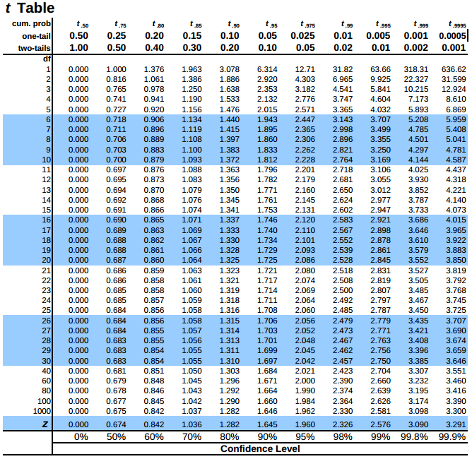
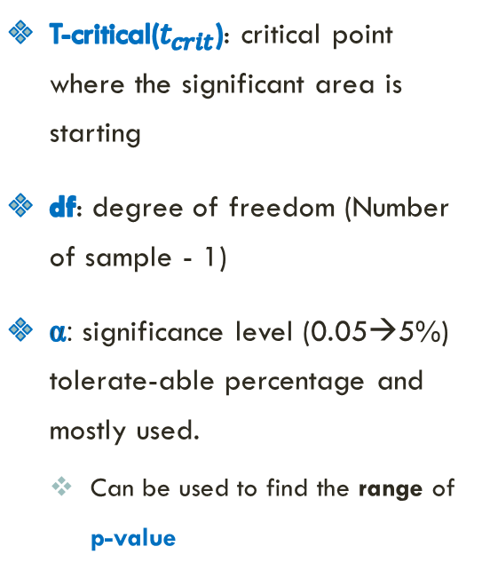

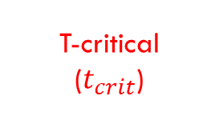

Determining t-critical value $\left(t_{crit}\right)$ on the T-table
$$α$$
T-critical($t_{crit}$): critical point where the significant area is starting
df: degree of freedom (Number of sample - 1)
α: significance level (0.05→5%) tolerate-able percentage and mostly used.
Can be used to find the range of p-value
T-critical
($t_{crit}$)
Notes:
Before explaining the steps of the two-tailed test. I will present the requirements.
First, we need to know about t-tables.
T-table is the table that would be used in calculating T-test to find t-critical value.
T-critical value is the critical point where the significant area is starting
Here is the list of t-critical values. Which critical value would be used?
When we want to find t-critical value in a two-tailed test, we need to find it based on the number of samples we used. In this case is df (degree of freedom).
In addition, we need to find the Alpha (significance level) we used. Because we use a two-tailed test, this is the Alpha that we need to concern.
Because most studies use 0.05 for the significance level, then we use the same alpha. This column is the t-critical value that needs to be found.
Later, we also can use this t-table to find the range p-value. Because we use the t-table for manual testing, we can’t find the precise p-value. We only can find whether the p-value is between 0.05 and 0.1 or between 0.5 and 0.4, or soon.

Slide 14

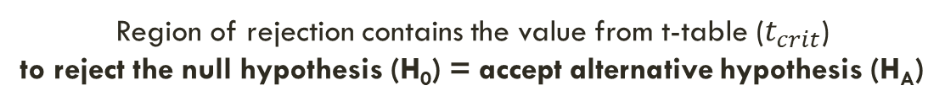

Determining t-critical value $\left(t_{crit}\right)$ on the T-table - Two-tailed (visualization)
$$t_{crit}$$
Region of rejection (H₀)
(Significant area)
0
Region of rejection (H₀)
(Significant area)
Region of rejection contains the value from t-table ($t_{crit}$) to reject the null hypothesis (H₀) = accept alternative hypothesis (H_{A})
Notes:
This is the illustration when we set the t-critical value.
T-critical values are used to define the starting point for the region of rejection in the distribution just like the following picture.
Since we use a two-tailed test, then we set t-critical values for each region (left and right) of rejections.

Slide 15
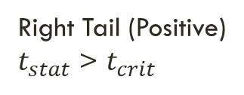
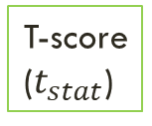
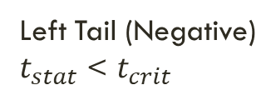
distribution for Two-tailed (visualization)
$$t_{crit}$$
Left Tail (Negative)
$t_{stat}$ < $t_{crit}$
Right Tail (Positive)
$t_{stat}$ > $t_{crit}$
Region of rejection (H₀)
(Significant area)
0
Region of rejection (H₀)
(Significant area)
T-score
($t_{stat}$)
Reject Null Hypothesis (H₀) = Accept Alternative Hypothesis (H_{A})
The two groups have a significant difference
Notes:
After finding t-critical values, then we need to calculate a t-score/t-statistic. This is the main calculation of the t-test.
The goal of t-score is to determine whether we accept/reject null/alternative hypothesis.
If the t-statistic on the right tail/positive area and fulfill t-statistic > t-critical just like the following example then we reject the null hypothesis which is equal to accepting the alternative hypothesis. The same result also happened in the opposite tail/negative area just like the following example if t-statistic < t-critical
If that is the case, then it means The two groups have a significant difference

Slide 16
distribution for Two-tailed (visualization)
$$t_{crit}$$
Left Tail (Negative)
$t_{stat}$ < $t_{crit}$
Right Tail (Positive)
$t_{stat}$ > $t_{crit}$
Region of rejection (H₀)
(Significant area)
0
Region of rejection (H₀)
(Significant area)
T-score
($t_{stat}$)
Accept Null Hypothesis (H₀) = Reject Alternative Hypothesis (H_{A})
The two groups do not have a significant difference
Notes:
On the contrary, if the t-statistic is in the middle of distribution which means it does not fulfill these conditions. Then we accept the null hypothesis which is equal to rejecting the alternative hypothesis.
It means the two groups do not have a significant difference.

Slide 17
Range p-value on the T-table
H₀: The means of two samples are similar → two groups are not significant
P-value ≤ 0.05 → accept alternative hypothesis (two groups are significant)
The feature is significantly different → Feature can be used/Keep the feature.
P-value > 0.05 → accept the null hypothesis (two groups are not significant)
The feature is not significantly different → Feature can’t be used/Delete the feature.
Notes:
According to the absolute t-statistic and the t-table information, we can guess the range p-value for our test.
If the null hypothesis refers to the means of two samples being similar reflecting two groups are not significantly different.
Then, if the range p-value is less than equals 0.05, we reject the null hypothesis which equals accepting alternative hypotheses. It illustrates that if we test features, then the feature can be used/kept.
Otherwise, it illustrates that the feature can’t be used/deleted.

Slide 18
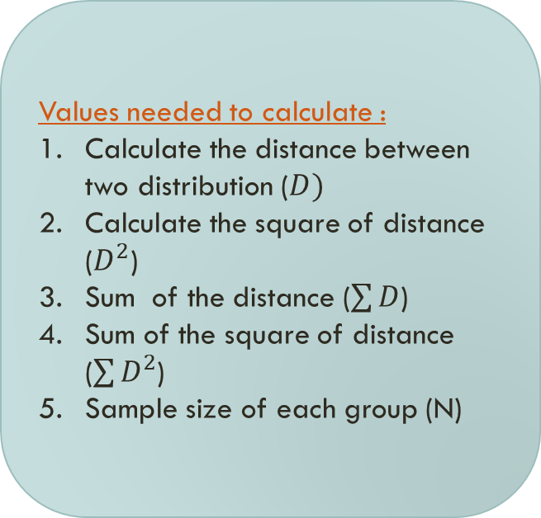
T-Test Feature selection
Identify Populations and distribution
Assign each population to one of two groups
Calculate T-Statistic
Determine the t-critical value and range p-value on the t-distribution table
Values needed to calculate :
Calculate the distance between two distribution ($D)$
Calculate the square of distance ($D^{2}$)
Sum of the distance ($\sum{D}$)
Sum of the square of distance ($\sum{D^{2}}$)
Sample size of each group (N)
Make a decision
Does the feature has a significant difference?
Notes:
Here I will explain step by step how to use a two-tailed test for feature selection, whether the feature has a significant difference then later decide if the feature can be used or need to be deleted.
Identify populations
Assign each population
Calculate t-statistic. Values needed to calculate
Determine t-critical values and range p-value on t-table
Decide whether feature is significant then can be used/deleted

Slide 19

T-TEST
EXAMPLE 1 – FEATURE 1
Notes:
For the first example, we want to test the significance difference of feature 1.

Slide 20
Identify population and distribution (1/5)
Feature 1
(F1)
F2
Row | Name | F1-GA | F2-GA
1 | A | 0.2 | 0.1
2 | B | 0.3 | 0.6
3 | C | 0.1 | 0.3
4 | D | 0.6 | 0.2
Two Groups (GA and GB)
Dataset
Row | Name | F1-GB | F2-GB
5 | E | 0.2 | 3
6 | F | 0.4 | 2
7 | G | 0.5 | 4
8 | H | 0.4 | 1
will be tested feature
Notes:
First-step: identify population and distribution. These are our samples. There are two groups (GA and GB) and this column is for feature 1 (F1) that will be tested.

Slide 21
Assign each population to one of two groups (2/5)
Example of t-test to test the difference between feature 1 in group A and group B
F1
F2
Row | Name | F1-GA | F2-GA
1 | A | 0.2 | 0.1
2 | B | 0.3 | 0.6
3 | C | 0.1 | 0.3
4 | D | 0.6 | 0.2
Feature 1
F1-GA
0.2
0.3
0.1
0.6
F1-GB
0.2
0.4
0.5
0.4
Two Groups
Dataset
Row | Name | F1-GB | F2-GB
5 | E | 0.2 | 3
6 | F | 0.4 | 2
7 | G | 0.5 | 4
8 | H | 0.4 | 1
will be tested feature
Notes:
Second-step: assign each population to one of two groups. According to feature 1 column, this one is the population data for GA and the right one is the population data for GB.

Slide 22
T-statistic: Values need to be calculated (3/5)
Notation | Meaning
$$D$$ | The distance between two distribution
$$D^{2}$$ | The Square of distance between two distribution
$$\sum{D}$$ | The sum of the distance between two distribution
$$\sum{D^{2}}$$ | The sum of the square of distance between two distribution
$$N$$ | Sample size of each group
Notes:
Third-step: Calculate the T-statistic. As I mentioned before, to calculate the T-statistic, we need the following values.

Slide 23
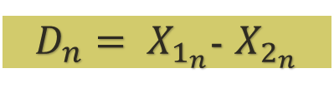

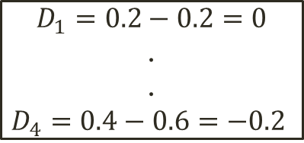
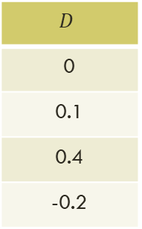
1. Calculate The distance $(D)$ (3/5)
The distance between two distribution
F1-GA
0.2
0.4
0.5
0.4
F1-GB
0.2
0.3
0.1
0.6
$$D$$
0
0.1
0.4
-0.2
$D_{n}= X_{1_{n}}$- $X_{2_{n}}$
(1)
$$D_{1}=0.2−0.2=0$$
.
.
$$D_{4}=0.4−0.6=−0.2$$
Notes:
1. Calculate the distance between two distributions. To calculate the distance, subtract for each data of the first group (GA) to each data of the second group (GB). For example for the first row, 0.2 subtract to 0.2 equals to 0. Do the same process to the end of row.

Slide 24


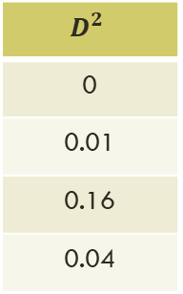
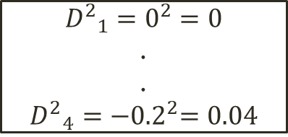
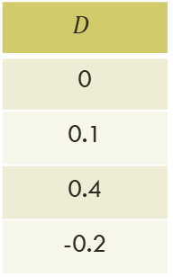
2. Calculate The square of distance $(D^{2})$ (3/5)
The Square of distance between two distribution
F1-GA
0.2
0.4
0.5
0.4
F1-GB
0.2
0.3
0.1
0.6
$$D$$
0
0.1
0.4
-0.2
$$D^{2}$$
0
0.01
0.16
0.04
$${D^{2}}_{n}={D_{n}}^{2}$$
(2)
$${D^{2}}_{1}=0^{2}=0$$
.
.
$${D^{2}}_{4}={−0.2}^{2}=0.04$$
Notes:
2. Calculate the square of distance between two distributions just like the following example. Square of 0 is 0, square of 0.1 is 0.01, and soon

Slide 25



3. Determine the Sample size ($N$) (3/5)
Sample size ($N$) is amount of data of each group
F1-GA
0.2
0.4
0.5
0.4
F1-GB
0.2
0.3
0.1
0.6
$N$= 4
Notes:
3. Then we can determine the sample size (N). The sample size here is the amount of data of each group. For this example, GA and GB have same size so the N equals to 4

Slide 26




4. Determining degree of freedom (DF) (3/5)
Degree of freedom is the number of values in the final calculation that are free to vary.
Example:
F1-GA
0.2
0.4
0.5
0.4
F1-GB
0.2
0.3
0.1
0.6
Degree of Freedom (df) = $N$-1
$$df=4−1=3$$
$N$=4
$N$=4
Notes:
4. Next we can determine the df (degree of freedom). Df is the number of values in the final calculation that are free to vary.
According to df calculation (N-1), then we can find 3 is the df.

Slide 27
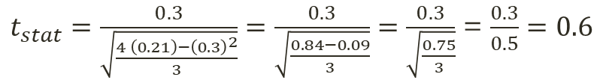
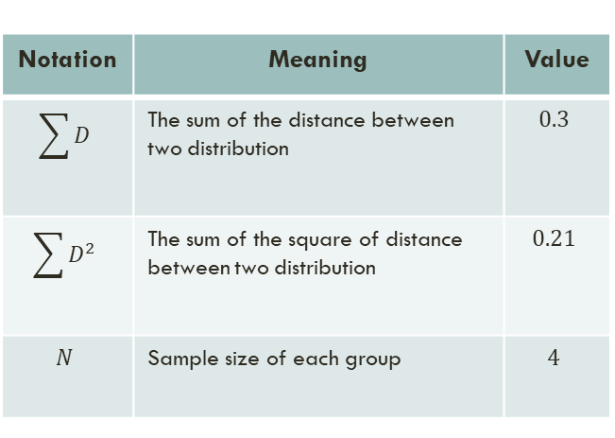
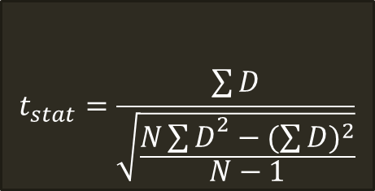

5. Calculation of T-score ($t_{stat}$) (3/5)
Notation | Meaning | Value
$$\sum{D}$$ | The sum of the distance between two distribution | $$0.3$$
$$\sum{D^{2}}$$ | The sum of the square of distance between two distribution | $$0.21$$
$$N$$ | Sample size of each group | $$4$$
$$t_{stat}=\frac{\sum{D}}{\sqrt{\frac{{N\sum{D}}^{2}−{(\sum{D})}^{2}}{N−1}}}$$
(3)
$t_{stat}=\frac{0.3}{\sqrt{\frac{4 \left(0.21\right)−{\left(0.3\right)}^{2}}{3}}}=\frac{0.3}{\sqrt{\frac{0.84−0.09}{3}}}=\frac{0.3}{\sqrt{\frac{0.75}{3}}}$ = $\frac{0.3}{0.5}=0.6$
Notes:
5. Finally this is the calculation of t-statistic. To calculate the t-statistic, we need the sum of distance between two distributions and its square, the sum of square of distance between two distributions, and sample size.
So this is the value needed to calculate t-statistic. Using this equation, we can find that t-statistic equals to 0.6

Slide 28
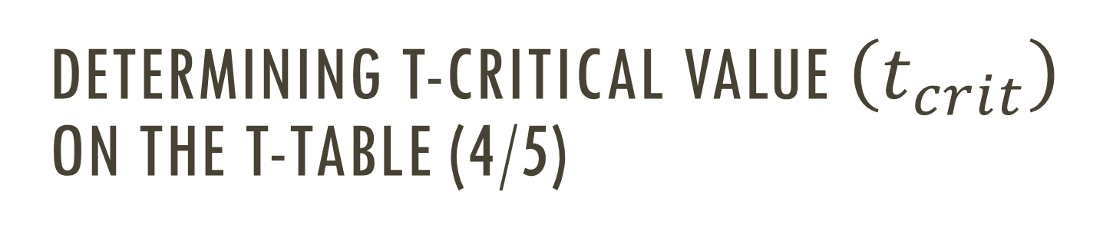

Determining t-critical value $\left(t_{crit}\right)$ on the T-table (4/5)
T-score($t_{stat}$) = 0.6
Degree of freedom (df): 3
α = 0.05 (5%)
Notes:
After calculating the t-statistic, the fourth-step is determining t-critical value.
Then we need to check on the t-table again. Remember that we use a two-tailed test so this is the alpha that we are concerned about.
According to df equals to 3 and alpha 0.05, then we can see, the selected t-critical value is 3.182

Slide 29

Determining Range p-value on the T-table (4/5)
T-score($t_{stat}$) = 0.6
Degree of freedom (df): 3
α = 0.05 (5%)
Find Range P-VALUE:
0.5<P-value<1.00
Check using system: 0.591
Notes:
And according to t-statistic value, 0.6. The range p-value is between 0.5 and 1.
Using system, Matlab code, the p-value also in the selected range, 0.591

Slide 30



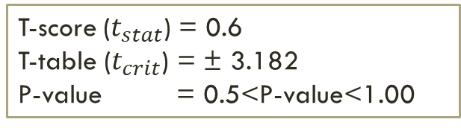
Make decision (5/5)
Right tail (Positive Area)
-3.182
0
0.6
3.182
Region of rejection (H₀)
0
Region of rejection (H₀)
$$t_{crit}$$
$$t_{stat}$$
$$t_{crit}$$
Region of rejection contains the value from t-table to reject the null hypothesis
T-score ($t_{stat}$) = 0.6
T-table ($t_{crit}$) = ± 3.182
P-value = 0.5<P-value<1.00
Result:
The t-stat is not in region of rejection so that we accept the null Hypothesis = Reject Alternative hypothesis
p-value ≥ 0.05; The feature has no significant difference → The feature can’t be used.
Notes:
The last step, to make a decision, we remind you about this distribution picture.
Region of rejection contains the value from t-table to reject the null hypothesis.
According to t-statistic, t-critical value, and selected range p-value, then the distribution picture becomes like this.
So we can conclude that:
The t-stat is not in region of rejection so that we accept the null Hypothesis = Reject Alternative hypothesis
P Value greater equals to 0.05 The feature has no significant difference The feature can’t be used.

Slide 31
Make decision (5/5)
The features has no significant difference
F1
F2
Feature 1 Can’t be used
Index | Name | F1-GA | F2-GA
1 | A | 0.2 | 0.1
2 | B | 0.3 | 0.6
3 | C | 0.1 | 0.3
4 | D | 0.6 | 0.2
Two Groups
Dataset
Index | Name | F1-GB | F2-GB
5 | E | 0.2 | 3
6 | F | 0.4 | 2
7 | G | 0.5 | 4
8 | H | 0.4 | 1

Slide 32
T-TEST
EXAMPLE 2 – FEATURE 2
Notes:
We also provide other tests for the second feature which produce the opposite decision, that is feature 2 can be used.

Slide 33
Identify population and distribution (1/5)
Row | Name | Feature 1 | Feature 2
1 | A | 0.2 | 0.1
2 | B | 0.3 | 0.6
3 | C | 0.1 | 0.3
4 | D | 0.6 | 0.2
Group A
Two Groups
Dataset
Row | Name | Feature 1 | Feature 2
5 | E | 0.2 | 3
6 | F | 0.4 | 2
7 | G | 0.5 | 4
8 | H | 0.4 | 1
Group B
will be tested feature
Notes:
Using the same process as the previous example, the first step is identifying population and distribution.
Because we want to test the second feature for the current example, then we only focus on the second column.
Actually, according to the data of two groups we can see the differences. So let's see whether this second feature really can be used because has significant difference

Slide 34
Assign each population to one of two groups (2/5)
Example of t-test to test the difference between feature 2 in group A and group B
Row
1
2
3
4
Feature2, Group A (F2-GA)
0.1
0.6
0.3
0.2
F2-GB
3
2
4
1
Feature 2

Slide 35
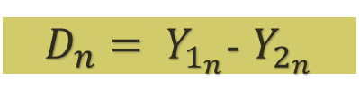
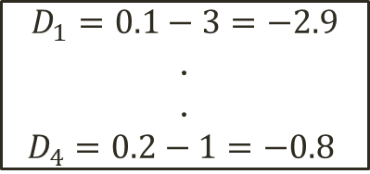
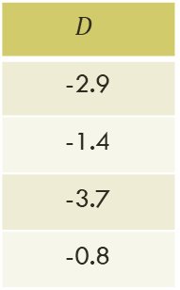
1. Calculate The distance $(D)$ (3/5)
The distance between two distribution
F2-GA
0.1
0.6
0.3
0.2
F2-GB
3
2
4
1
$$D$$
-2.9
-1.4
-3.7
-0.8
$D_{n}= Y_{1_{n}}$- $Y_{2_{n}}$
$$D_{1}=0.1−3=−2.9$$
.
.
$$D_{4}=0.2−1=−0.8$$

Slide 36

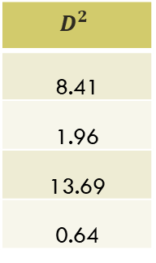
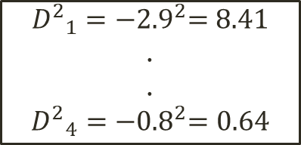
2. Calculate The square of distance $(D^{2})$ (3/5)
The Square of distance between two distribution
F2-GA
0.1
0.6
0.3
0.2
F2-GB
3
2
4
1
$$D$$
-2.9
-1.4
-3.7
-0.8
$$D^{2}$$
8.41
1.96
13.69
0.64
$${D^{2}}_{n}={D_{n}}^{2}$$
$${D^{2}}_{1}={−2.9}^{2}=8.41$$
.
.
$${D^{2}}_{4}={−0.8}^{2}=0.64$$

Slide 37
3. Determine the Sample size ($N$) (3/5)
Sample size ($N$) is amount of data of each group
F2-GA
0.1
0.6
0.3
0.2
F2-GB
3
2
4
1
$N$= 4

Slide 38
4. Determining degree of freedom (DF) (3/5)
Degree of freedom is the number of values in the final calculation that are free to vary.
Example:
F2-GA
0.1
0.6
0.3
0.2
F2-GB
3
2
4
1
Degree of Freedom (df) = $N$-1
$$df=4−1=3$$
$N$=4
$N$=4

Slide 39
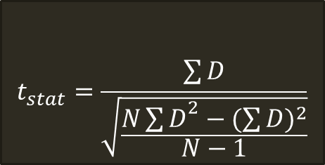
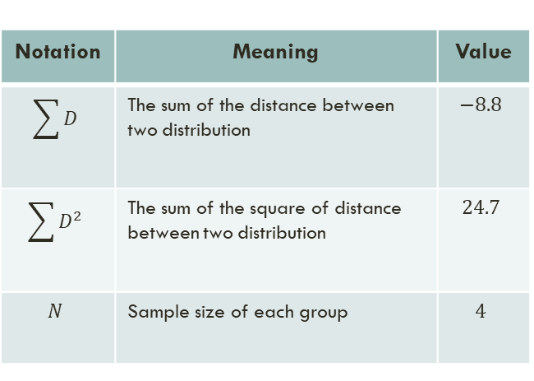
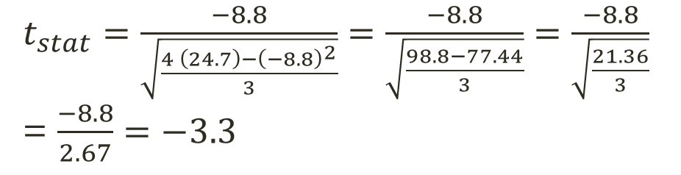
5. Calculation of T-score ($t_{stat}$) (3/5)
$$t_{stat}=\frac{\sum{D}}{\sqrt{\frac{{N\sum{D}}^{2}−{(\sum{D})}^{2}}{N−1}}}$$
Notation | Meaning | Value
$$\sum{D}$$ | The sum of the distance between two distribution | $$−8.8$$
$$\sum{D^{2}}$$ | The sum of the square of distance between two distribution | $$24.7$$
$$N$$ | Sample size of each group | $$4$$
$t_{stat}=\frac{−8.8}{\sqrt{\frac{4 \left(24.7\right)−{\left(−8.8\right)}^{2}}{3}}}=\frac{−8.8}{\sqrt{\frac{98.8−77.44}{3}}}=\frac{−8.8}{\sqrt{\frac{21.36}{3}}}$ = $\frac{−8.8}{2.67}=−3.3$

Slide 40
Determining t-critical value $\left(t_{crit}\right)$ on the T-table (4/5)
T-score = -3.3
Degree of freedom (df): 3
α = 0.05 (5%)

Slide 41
Determining range P-value on the T-table (4/5)
T-score = -3.3
Degree of freedom (df): 3
α = 0.05 (5%)
Find Range P-VALUE:
0.02<P-value<0.05
Check using system: 0.046

Slide 42



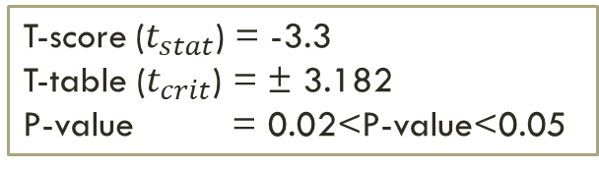
Make decision (5/5)
T-score ($t_{stat}$) = -3.3
T-table ($t_{crit}$) = ± 3.182
P-value = 0.02<P-value<0.05
-3.3
-3.182
0
3.182
$$t_{stat}$$
$$t_{crit}$$
$$t_{crit}$$
Result:
The t-stat is in region of rejection so that we reject the null Hypothesis = accept alternative hypothesis
p-value ≤ 0.05; The features has significant difference → The feature can be used.

Slide 43
Make decision (5/5)
The features has no significant difference
F1
F2
Feature 1 Can’t be used
Index | Name | F1-GA | F2-GA
1 | A | 0.2 | 0.1
2 | B | 0.3 | 0.6
3 | C | 0.1 | 0.3
4 | D | 0.6 | 0.2
Feature 2 is useful
Two Groups
Dataset
Index | Name | F1-GB | F2-GB
5 | E | 0.2 | 3
6 | F | 0.4 | 2
7 | G | 0.5 | 4
8 | H | 0.4 | 1

Slide 44
THANK YOU

